Slide 1
Nicholas Grogg
Project 3: Part 2: The Plan

Slide 2
Introduction
X number of players
Phrase of Y length
Players take turns saying a single word
Whoever says the last word is out
Goes on until one player is left
2 < X < 10
1 < Y < 10
Graphic example on next slide

Slide 3
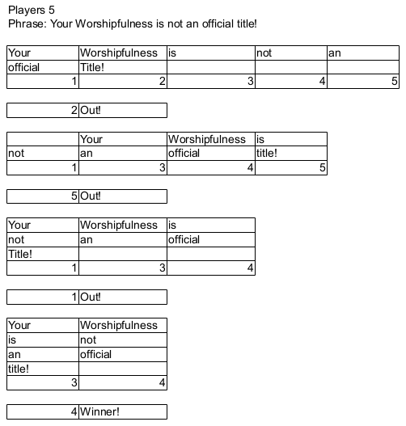


Slide 4
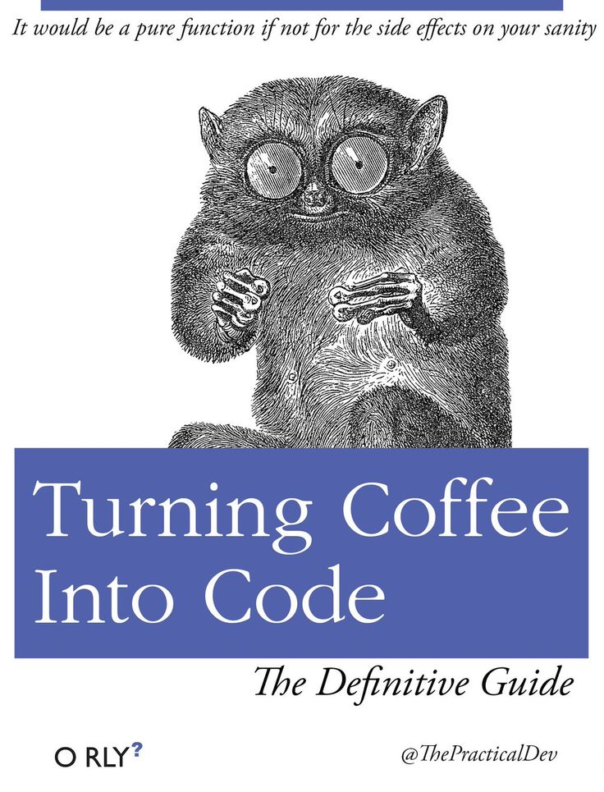
Overview
Extension of Linked List Lab
Circular linked list
Program in a while loop
User decides phrase length
User decides number of players
Both use while loop verification
Struct linked list
Struct in a class

Slide 5

Progression
User enters # of players
User enters # of words
User enters words
Program finds last player
Ask if user wants to play again

Slide 6
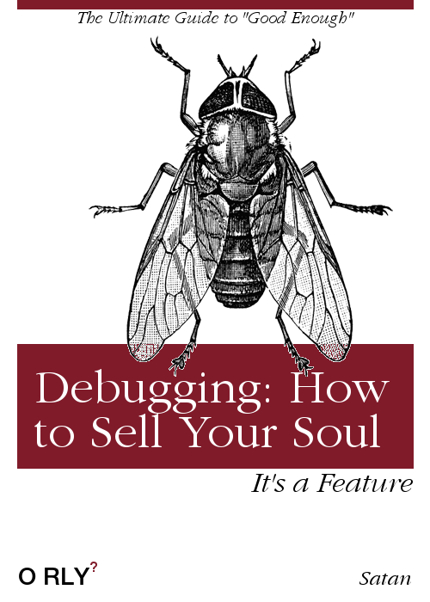
Files and Classes
Class for Linked List
Struct for nodes
3 files
Main.cpp
Class.cpp
Class.h
Will try to avoid arrays

Slide 7
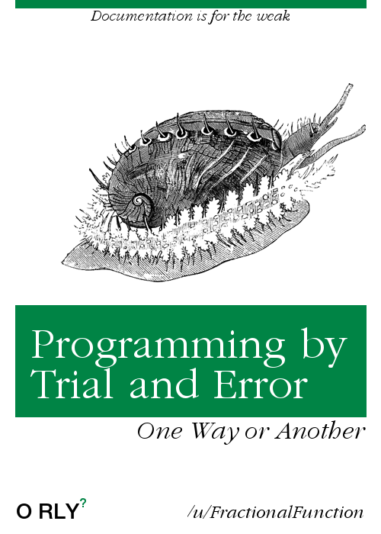
Variables (Main)
Int playercount
Int wordcount
Bool Keepplaying
True by default
Array if primary plan fails
Backup plan, shouldn't need

Slide 8
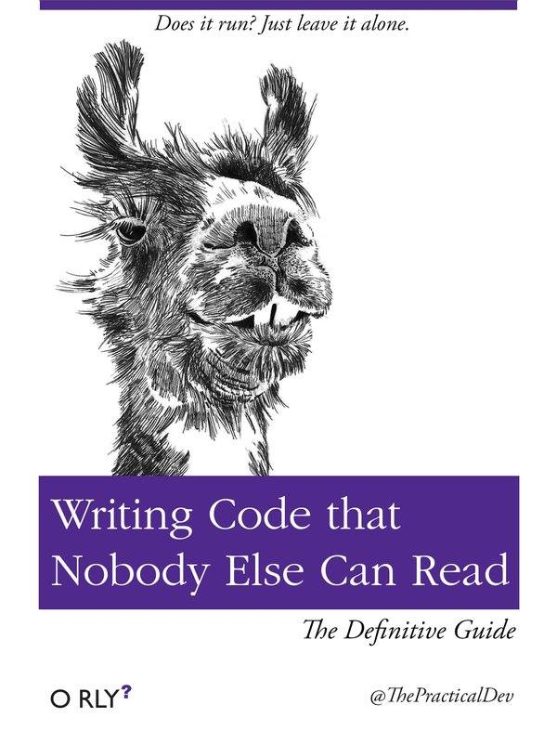
Variables (Class)
ListNode *head
String name for node
Int node, for keeping track of nodes
String nodeword
Holds a word
Will have many of these

Slide 9

Functions
Constructor, Destructor
Void Add/Remove Node
Void AddWord, add word to node
Void OutputNode, output nodes
Array2Node if plan fails (backup)

Slide 10
